Slide 1
Machine Learning in Practice I
Lecture 12
Antal Jakovac, 2025

Slide 2
Examples from Computer Vision

Slide 3


Examples from Computer Vision
After learning the most important ML methods, let us apply them!
Possible application area: Computer Vision (cv)
Examples of popular databases:
  sklearn’s load_digits dataset
  sklearn’s fetch_lfw_people dataset
  MNIST dataset

Slide 4
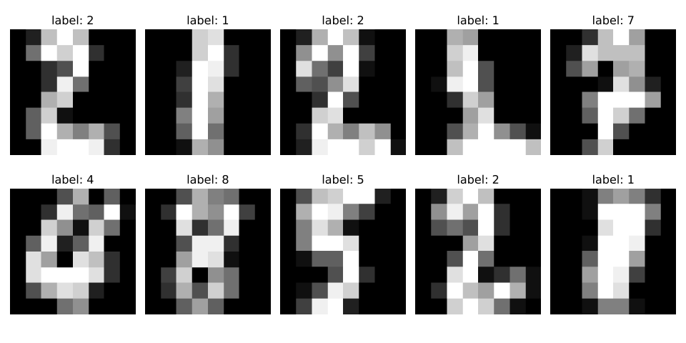
load_digits dataset
database properties
  contains images of handwritten characters: 0-9 (10 classes)
  contains 1797 sample, 8x8 grayscale (4 bit) images
  originally collected by the UCI Machine Learning Repository in the 1980s–1990s, from scanned postal code digits and forms
  one of the first machine learning benchmark studies for optical character recognition (OCR), preceding MNIST
  in Python available as
  from sklearn.datasets import load_digits

Slide 5
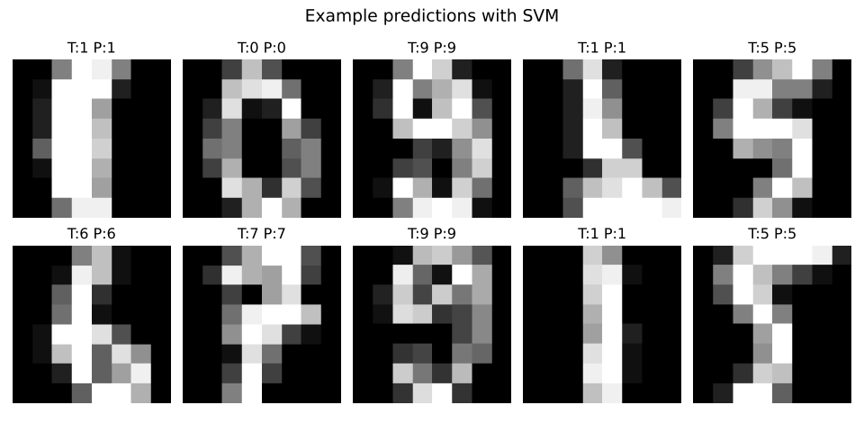
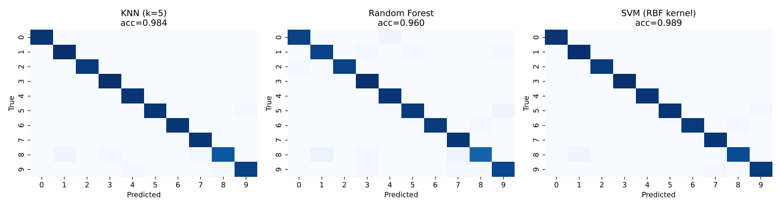
load_digits dataset
basic classifiers
  train KNN, RF and SVM on the data
  very good results!

Slide 6
load_digits dataset
accuracies:
method | accuracy
DT | 82.0%
RF | 96.0%
Bagging | 92.2%
AdaBoost | 82.0%
KNN (k=5) | 98.4%
SVM (RBF kernel) | 98.9%
NaiveBayes | 82.3%
ELM (30k hidden) | 98.7%
LLT | 98.4%

Slide 7
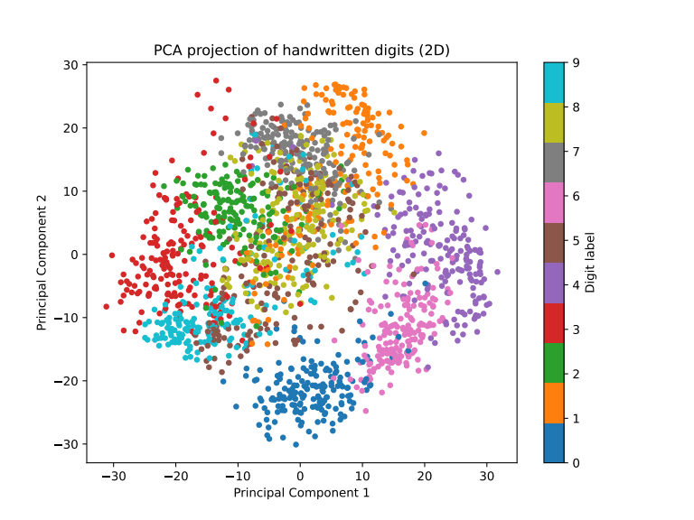
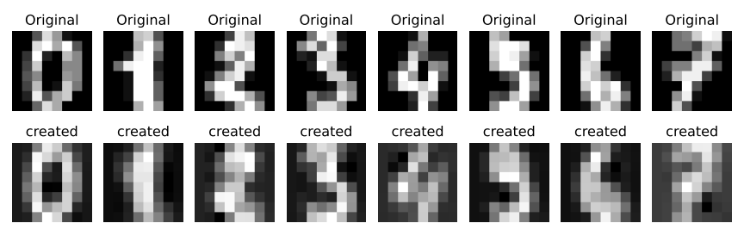
load_digits dataset
data compression and reconstruction → PCA
PCA 13 component reconstruction

Slide 8
Lessons and conclusions

Slide 9
Conclusions and lessons
there are a lot of models for few degrees of freedom
most powerful
  for classification: RF, KNN, SVM → ELM, LLT
  compression: PCA
  unsupervised clusterization: GMM
for lot of degrees of freedom: lose efficiency
solution: hierarchical approach, process a small portion per step
  deep neural networks: translation (CNN) + scaling (pooling)
  LLMs: attention heads

Slide 10
END OF LECTURE 12

